Slide 1






Slide 2






Slide 3





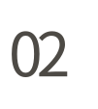

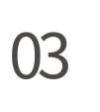






Slide 4




Slide 5







Slide 6




Slide 7










Slide 8



Slide 9






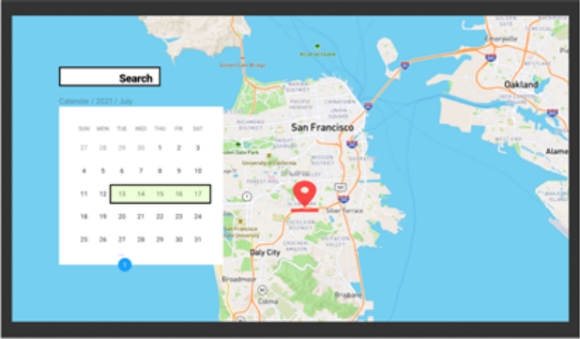
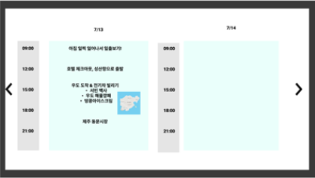
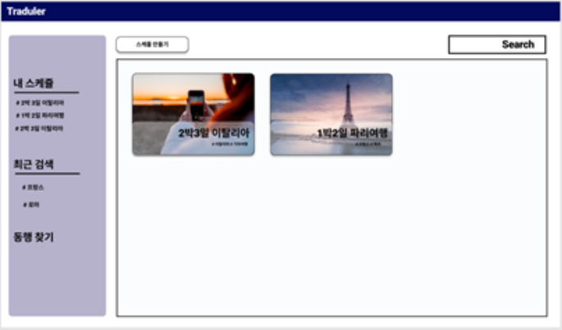
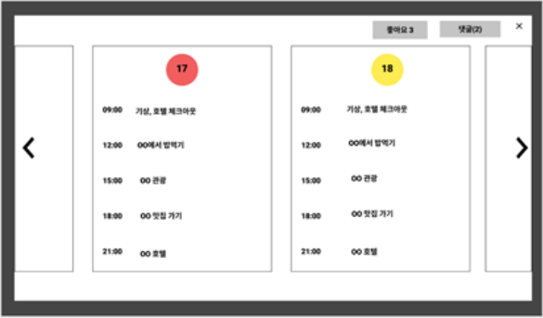

Slide 10



Slide 11

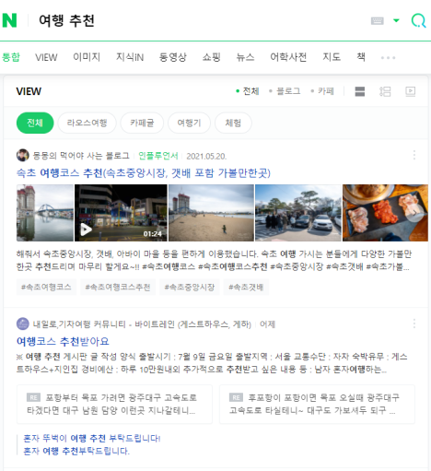



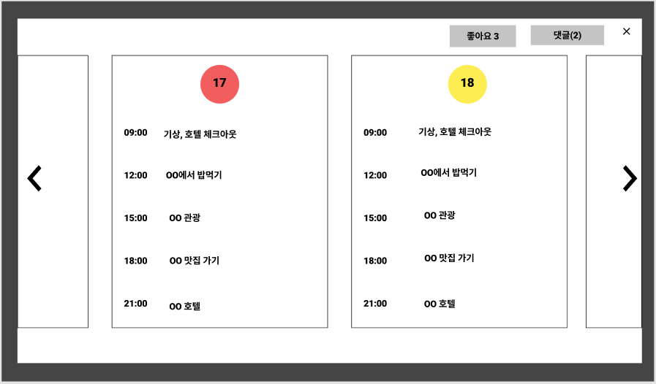




Slide 12











Slide 13










Slide 14



Slide 15













Slide 16















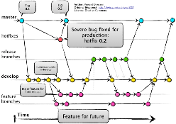
8080
3306
http2
6379
Database Replication
Cache
8081
Reverse proxy Load Balancer
CDN
3307
9090
CD
CI
push

Slide 17



